Slide 1
Advanced Computational Science
Articulation Points in Multiplex Networks
Student: Artem Vergazov
Research Advisor: Vladimir Palyulin
January 2023

Slide 2
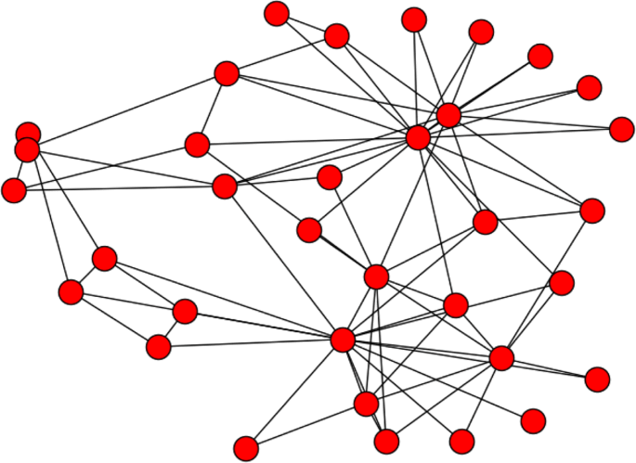
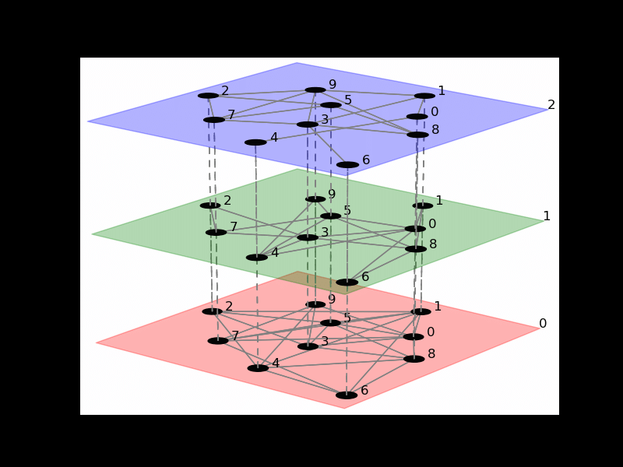
Introduction. Networks
Simple network
Multiplex network
Notes:
The area of my research covers articulation points behavior in multiplex networks. First let me introduce the basic notions.
Many of the physical systems are represented efficiently by a notion of graphs, or networks. A model of graph provides the framework for modeling entities (nodes) and their interactions (edges). However, some phenomena are more naturally described by multiplex networks. A multiplex network is a collection of simple networks, or layers, where all the nodes exist simultaneously in all the layers but the links within each layer can differ.

Slide 3

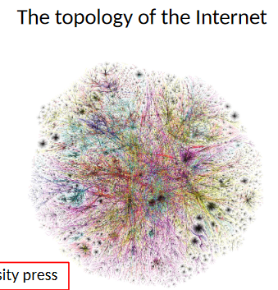
Introduction. Networks
Multiplex network examples
Transport
Underground layer
Bus layer
Social
Twitter layer
LinkedIn layer
Notes:
Examples of networks vary and can be found in different fields of science. For example, social networks, the Internet. An example of a multiplex network can be a transportation network, or a social network, too.

Slide 4
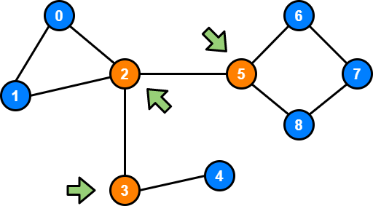
Introduction. Definitions
An articulation point (AP) is a node whose removal disconnects the graph
Articulation points (AP)
Notes:
An articulation point is any node in a graph whose removal increases the number of connected components, or simply disconnects the graph. Being able to find articulation points and understanding the patterns of their behavior can help prevent crucial systems from destruction or find weaknesses in such systems.

Slide 5
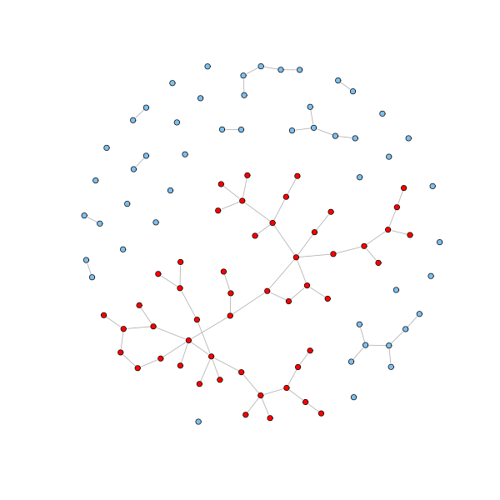
Introduction. Definitions
Giant connected component (GCC) is the largest connected component of the graph
Giant Connected Component (GCC)
Notes:
Another definition from network theory that will be crucial for the presentation is Giant Connected Component. Giant connected component (GCC) is the largest connected component of the graph.

Slide 6
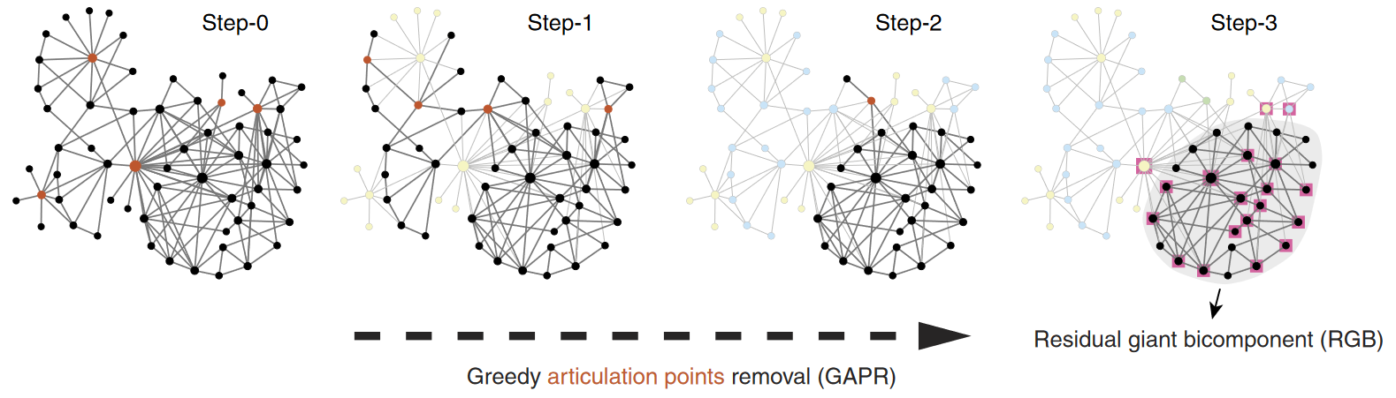
Introduction. Articulation points removal
Review: Tian, L. et al. Articulation points in complex networks.
Nat. Commun. 8, 14223 doi: 10.1038/ncomms14223 (2017).
Notes:
In the paper by Tian et. al., the process of greedy articulation points removal is described.

Slide 7
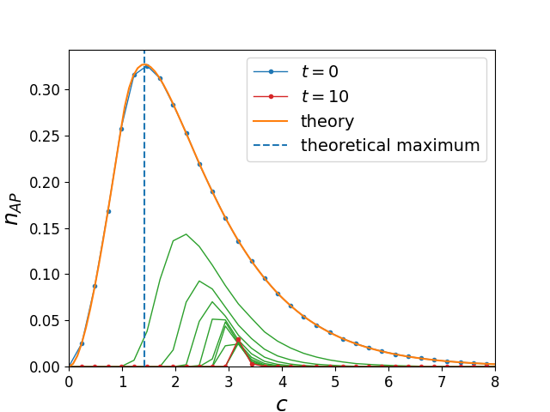
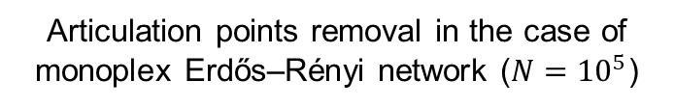
Introduction. Articulation points removal
Articulation points removal in the case of monoplex Erdős–Rényi network ($N={10}^{5}$)
Review: Tian, L. et al. Articulation points in complex networks.
Nat. Commun. 8, 14223 doi: 10.1038/ncomms14223 (2017).
Notes:
This process leads to a percolation phase transition at a critical threshold, which is significantly larger than the equivalent threshold for a single network. This example illustrates the difference between monoplex and multiplex networks and suggests that multiplex networks are treated as more complicated physical objects than single networks.

Slide 8
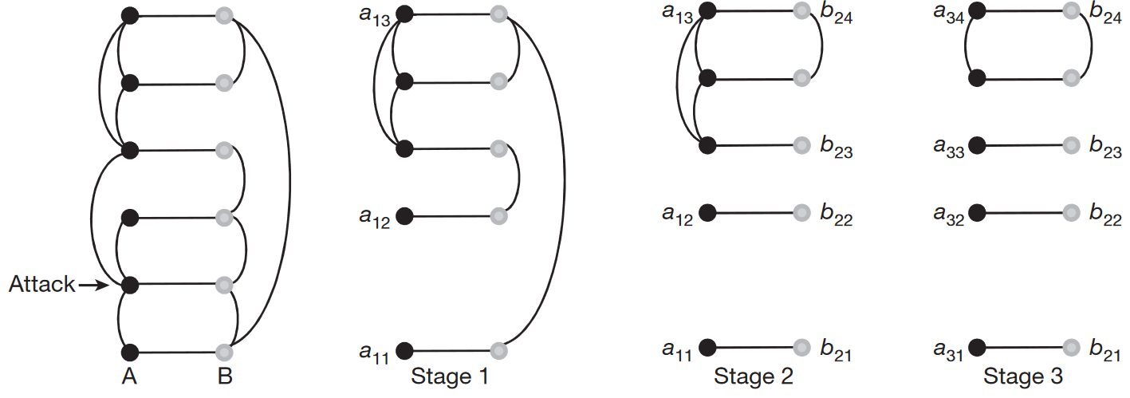
Introduction. Cascade failure of nodes
Review: Buldyrev, S., Parshani, R., Paul, G. et al. Catastrophic cascade of failures in interdependent networks. Nature 464, 1025–1028 (2010). https://doi.org/10.1038/nature08932
Notes:
However, to compare this result with the multiplex case, one must consider the effect of cascade of failures which only arises in the multiplex networks. When a certain node becomes disconnected from the network, it starts an avalanche-like process of failures of other nodes. For example, when one node fails, all its connections are removed from the network. Also, its replica from other layers of the network stop functioning, too. After the links are removed, each layer decays into sets of connected components. And the component can be considered functioning only if the nodes belonging to it coincide in all layers. Links between nodes of the layer b that correspond to different components in the layer a are removed, too, until no further splitting is possible.

Slide 9
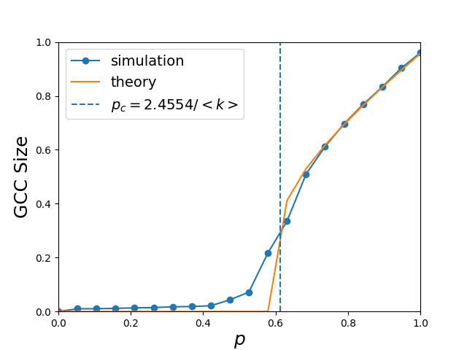
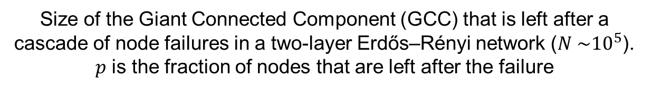
Introduction. Cascade failure of nodes
Size of the Giant Connected Component (GCC) that is left after a cascade of node failures in a two-layer Erdős–Rényi network ($N \sim {10}^{5}$). $p$ is the fraction of nodes that are left after the failure
Review: Buldyrev, S., Parshani, R., Paul, G. et al. Catastrophic cascade of failures in interdependent networks. Nature 464, 1025–1028 (2010). https://doi.org/10.1038/nature08932
Notes:
However, to compare this result with the multiplex case, one must consider the effect of cascade of failures which only arises in the multiplex networks. When a certain node becomes disconnected from the network, it starts an avalanche-like process of failures of other nodes. For example, when one node fails, all its connections are removed from the network. Also, its replica from other layers of the network stop functioning, too. After the links are removed, each layer decays into sets of connected components. And the component can be considered functioning only if the nodes belonging to it coincide in all layers. Links between nodes of the layer b that correspond to different components in the layer a are removed, too, until no further splitting is possible.

Slide 10
Aim
Study AP in multiplex networks with
cascade failure of nodes
articulation points removal strategy.
Study the difference in behavior (network attacks, node failure) between simple and multiplex cases
Notes:
So, the overall purpose of the work is to generalize the AP concepts to the multiplex case and compare the effects that occur between simple and multiplex cases.

Slide 11
Objectives
Study APs in Erdős–Rényi multiplex networks
Study APs in configuration networks
Check the statistics of real-world multiplex networks
Notes:
The objectives of my research are as follows:
1 Study the literature and reproduce the results for simple networks
2 Study APs distribution in Erdős–Rényi multiplex networks
3 Compare with the case of configuration networks
4 Do some analysis on real networks

Slide 12
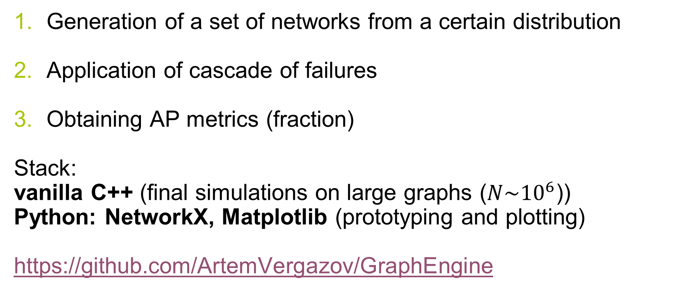
Algorithms and methodology
Generation of a set of networks from a certain distribution
Application of cascade of failures
Obtaining AP metrics (fraction)
Stack:
vanilla C++ (final simulations on large graphs ($N\sim {10}^{6}$))
Python: NetworkX, Matplotlib (prototyping and plotting)
https://github.com/ArtemVergazov/GraphEngine
Notes:
The usual outline for a numerical experiment with multiplex networks is as follows:
1 First generate a family of networks which are used to model the layers of the multiplex network
2 Apply the cascade of failures effect
3 Calculate the needed quantities, for example, the proportion of nodes which are APs
I do all simulations in Python and use the NetworkX open-source library which provides framework for graph manipulation.

Slide 13
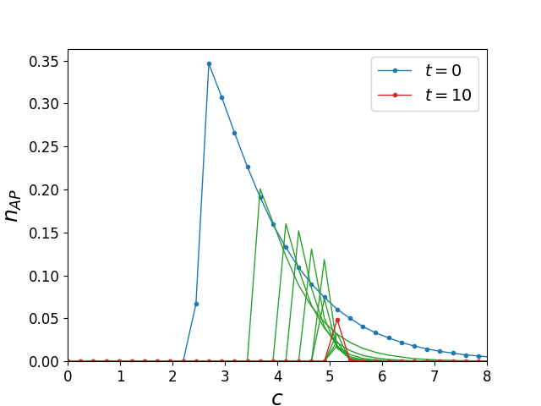
Results. ER multiplex network
Fraction of articulation points in Erdős–Rényi (ER) two-layer network ($N\sim {10}^{5}$). $c$ is the mean degree of the network nodes.
Notes:
The same experiment can be conducted for the multiplex case, but the cascade of failures effect has to be taken into account. One can see qualitatively different curves. Now it takes larger values of c to sustain a connected graph because of this effect. These are the new results for the multiplex network case.

Slide 14
Results. ER multiplex network
Monoplex case
Multiplex case
Notes:
Here are the two graphs for comparison. These results suggest that a multiplex network takes more connections than a monoplex network to stay functioning because of the cascade of failures effect. When building new systems with multilayer structure, these effects should be taken into account in order to avoid a system destruction in case of accidental node failure. It can also be seen that no giant component is possible after the cascade of failures in the multiplex network if c is less than 2.5, and the confirmation of this fact will be shown on the next slide.

Slide 15
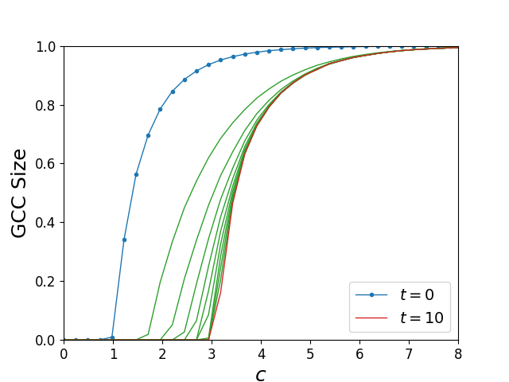
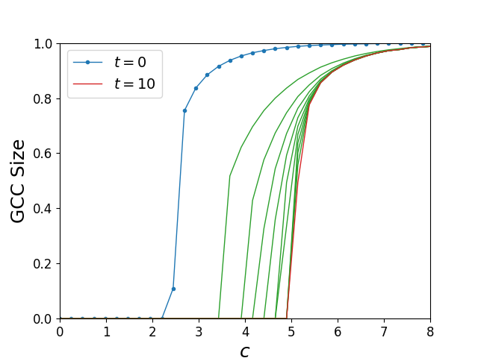
Results. GCC size
Relative size of the giant connected component (GCC) after t steps of AP removal, as a function of the mean degree c in ER monoplex and multiplex networks ($N\sim {10}^{5}$).
Monoplex case
Multiplex case
Notes:
The same experiment can be conducted for the multiplex case, but the cascade of failures effect has to be taken into account. One can see qualitatively different curves. Now it takes larger values of c to sustain a connected graph because of this effect. These are the new results for the multiplex network case.

Slide 16
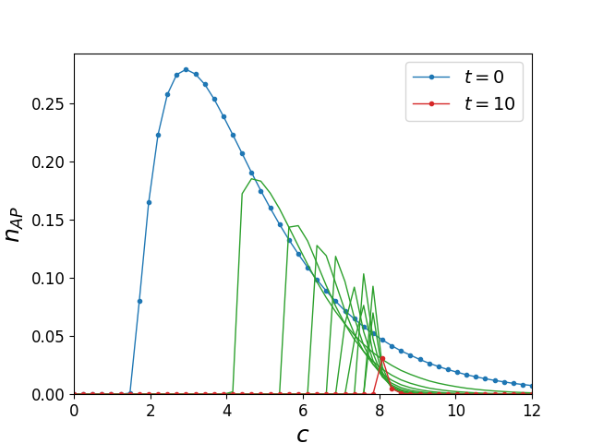
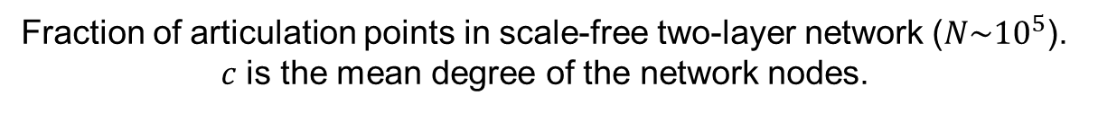
Results. Scale-free multiplex network
Fraction of articulation points in scale-free two-layer network ($N\sim {10}^{5}$). $c$ is the mean degree of the network nodes.
Notes:
The same experiment can be conducted for the multiplex case, but the cascade of failures effect has to be taken into account. One can see qualitatively different curves. Now it takes larger values of c to sustain a connected graph because of this effect. These are the new results for the multiplex network case.

Slide 17
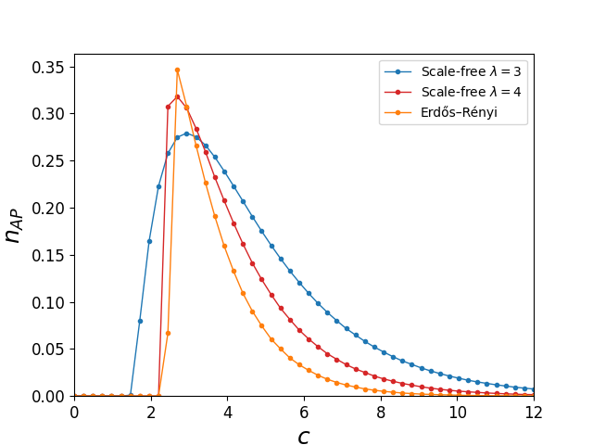
Results. Random graph models comparison
Notes:
The same experiment can be conducted for the multiplex case, but the cascade of failures effect has to be taken into account. One can see qualitatively different curves. Now it takes larger values of c to sustain a connected graph because of this effect. These are the new results for the multiplex network case.

Slide 18
Discussion and conclusions
Multiplex networks are less stable with phase transitions shifting to the right than monoplex networks
Probability of failure of such networks jumps
Notes:
[[Read the slide]] These results suggest that in both cases some sort of phase transition happens. However, in the multiplex case, the phase transition is harder to achieve, and it happens differently. This phenomenon requires further research.

Slide 19
Current status and outlook
A number of published results reproduced
APs removal strategy with cascade failure behavior studied on
Erdős–Rényi multiplex networks
scale-free multiplex networks
APs behavior comparison between different random graph model studied
Next steps:
May 2023: increase network size (millions of nodes)
May 2023: finalize thesis text
Notes:
Currently, the literature review is mostly done, results of the previous research have been reproduced and initial results on multiplex networks have been obtained. The future steps of the research are to do similar experiments with the configuration multiplex networks and then compare the results with the current results. Next stepa of the plan are to study some real network examples, present all results in a paper and, finally, work on thesis.

Slide 20
Acknowledgements
Prof. Vladimir Palyulin
Dr. Saeed Osat
Notes:
I am grateful to my advisor Professor Palyulin for his guidance and to Mr. Saeed Osat, who helped me with the experiments.

Slide 21
Thank you for attention
Notes:
Thank you for your attention. Now I’m ready to answer your questions.

Slide 22
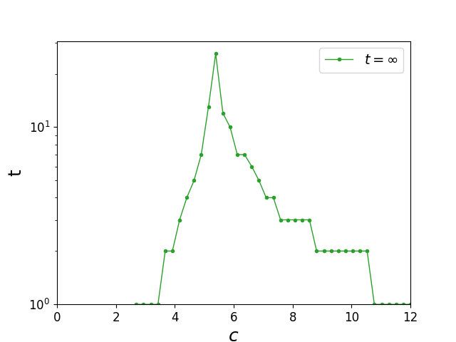
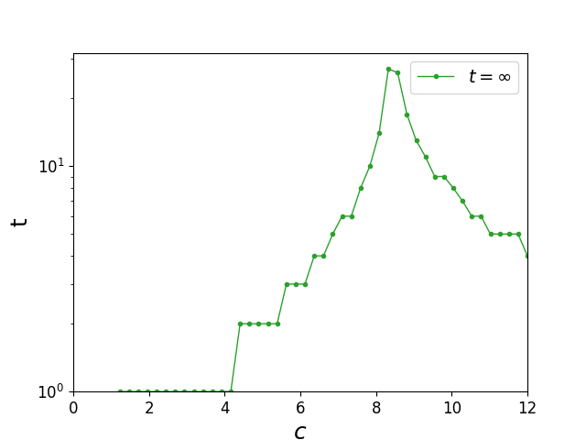
Appendix. Number of AP removal steps
Total number of AP removal steps as a function of mean degree c in multiplex ER and scale-free networks ($N\sim {10}^{5}$)
ER network
Scale-free network
Notes:
The same experiment can be conducted for the multiplex case, but the cascade of failures effect has to be taken into account. One can see qualitatively different curves. Now it takes larger values of c to sustain a connected graph because of this effect. These are the new results for the multiplex network case.

Slide 23
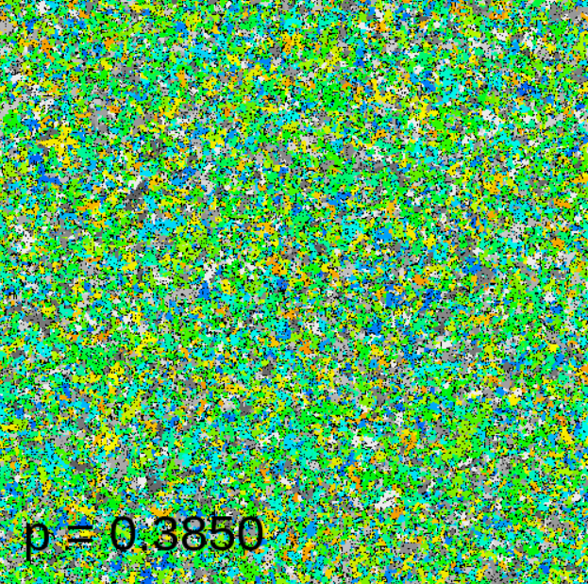
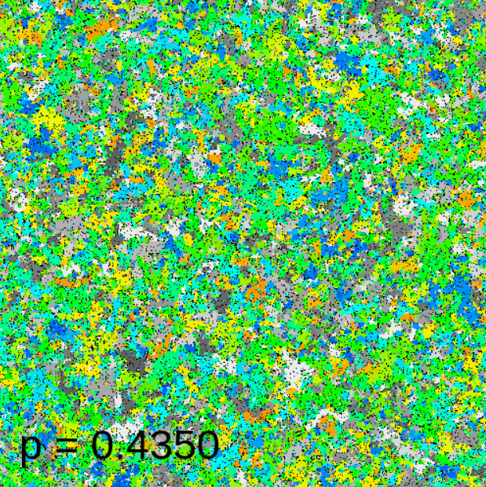
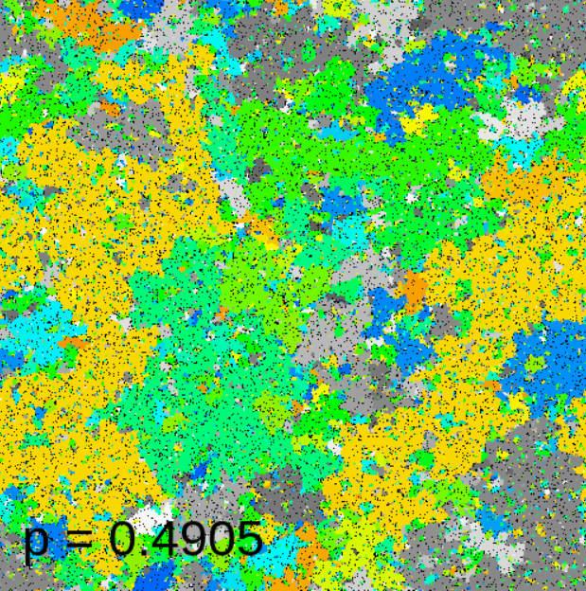
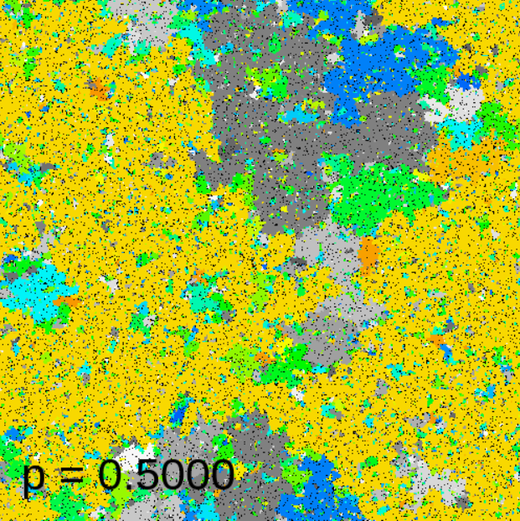
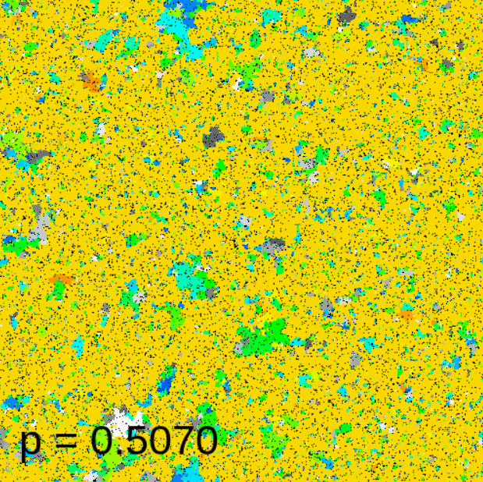
Introduction. Percolation
Notes:
One of the manifestations of the difference between a multiplex network and a monoplex network rises in the percolation theory. Consider a random graph whose two randomly chosen nodes are connected with probability p. If the parameter p increases, will there occur a giant connected component, a cluster of nodes that spans the entire network? It turns out that, in the limit of infinite network, there is a critical value of p: below that value, no giant cluster exists. This means that the system undergoes a phase transition at that critical value.

Slide 24
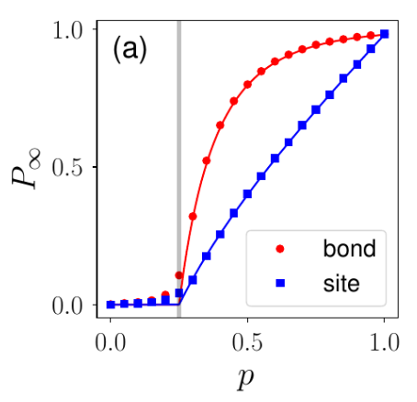
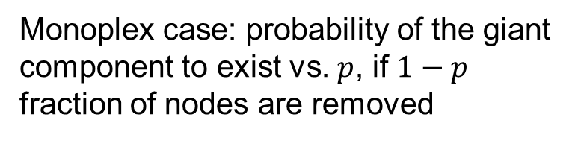
Introduction. Percolation
Monoplex case: probability of the giant component to exist vs. $p$, if $1−p$ fraction of nodes are removed
Notes:
For example, in this experiment, a fraction of nodes (1 - p) are removed from the network and the probability of existence of giant connected component is shown on the graph. There is a certain critical point at which the system undergoes a phase transition, and the existence of the giant component becomes possible.

Slide 25
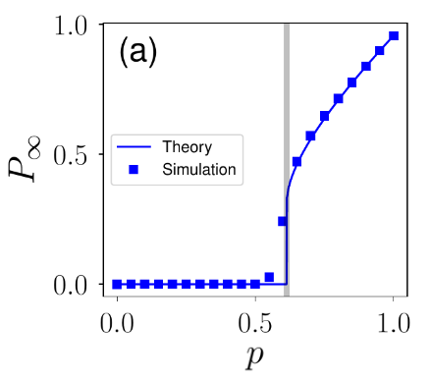
Introduction. Percolation
Monoplex case
Multiplex case
Notes:
This process leads to a percolation phase transition at a critical threshold, which is significantly larger than the equivalent threshold for a single network. This example illustrates the difference between monoplex and multiplex networks and suggests that multiplex networks are treated as more complicated physical objects than single networks.

Slide 26
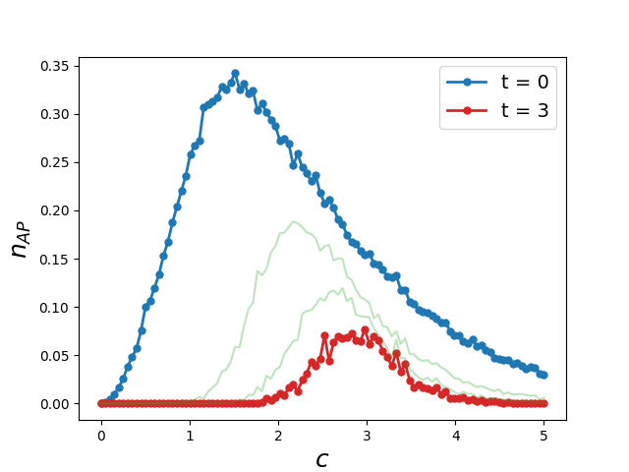
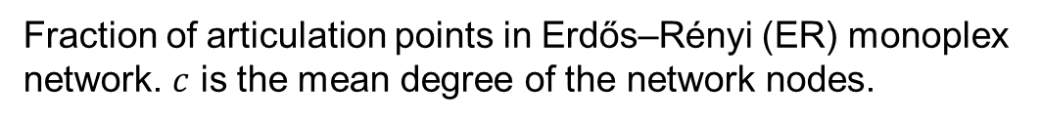
Results. Monoplex network
Fraction of articulation points in Erdős–Rényi (ER) monoplex network. $c$ is the mean degree of the network nodes.
Review: Tian, L. et al. Articulation points in complex networks.
Nat. Commun. 8, 14223 doi: 10.1038/ncomms14223 (2017).
Notes:
Here are reproduced results of the paper cited on the screen. The main idea of the experiment is as follows: at each step, all APs in the monoplex random graph are removed. At the next step, all APs of the resulting graph are removed, and so on. The graph displays the fraction of APs at each time step vs. the mean degree of the nodes. With each step, the peak of the curve shifts to the right which means that the number of links required to sustain a connected graph grows with the removal of nodes.

